Slide 1
Education 205
The Impact of Social and Behavioral Science Research on Educational Issues:
Focus on English Language Learners and Issues of Policy and Practice
History, Demographic Trends, and Policy Directions
March 30, 2010

Slide 2
Section 1
History

Slide 3
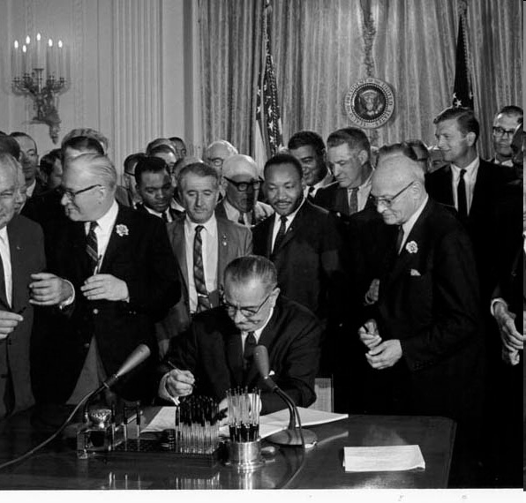
History
Notes:
Even though the history of ELL education in the US dates back into the 1800’s, we will start with the recent history that started with the Civil Rights Act of 1964.

Slide 4

History
Notes:
Here is another important picture from history.

Slide 5
Polling Question:
What important legal event happened in 1974 that had enormous impact on Limited English Proficient students?
Notes:
Here’s a polling question: [read question].
Notice Lau v. Nichols in responses.

Slide 6
History
_{Lau v. Nichols (1974)}
_{U.S. Supreme Court}
There is no equality of treatment merely by providing students with the same facilities, textbooks, teachers and curriculum; for students who do not understand English are effectively foreclosed from any meaningful education.
Notes:
Lau v. Nichols it is, a 1974 supreme court decision based in San Francisco.
The most important point of Lau is that equal treatment is not the same as equal opportunity. Different approach may be needed. It also separated language access from content access, and made it clear that access to both is necessary.

Slide 7
Castañeda v. Pickard (1981)
_{“Castañeda Standards”}
(1) Whether the school system is pursuing a program informed by an educational theory recognized as soundby some experts in the field, or, at least, deemed a legitimate experimental strategy.
(2) Whether the programs and practices actually used by the school system are reasonably calculated to implement effectivelythe educational theory adopted by the school.
(3) Whether the school's program succeeds, after a legitimate trial, to produce resultsindicating that the language barriers confronting students are actually being overcome.
Notes:
These are known as the three prongs of Castaneda. These standards have been adopted by the Office for Civil Rights of USDOE to test complaints filed re: ELL violating Lau.

Slide 8
Castañeda v. Pickard (1981)
_{Sound theory}
_{revise}
_{examine}
_{Results}
_{reform}
_{Implementation}
_{evaluate}
Notes:
Castaneda v. Pickard created an interpretation of “appropriate” services in EEOA, and created what is widely known as the “Castaneda standards”

Slide 9

_{Polling Question}
_{Link to Current Events}
Notes:
Polling question: Who has read about this news event in the papers?
The Castaneda framework will undoubtedly be used in the anticipated inquiry into LAUSD.
So history is really relevant even to present day events.

Slide 10
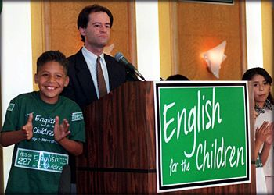
The Bilingual Wars
Notes:
One other bit of unavoidable history. What does this picture evoke in your memory? Type in the number of the ballot initiative in California that started this off. Proposition …

Slide 11
The Bilingual Wars
Notes:
Even though the most definitive conclusions from research showed that bilingual education programs are more effective than English-only programs in attaining achievement in English, as we shall see, what history tells us is that this is an issue that generates political heat, and inevitably slips back into discussions about program effectiveness.

Slide 12
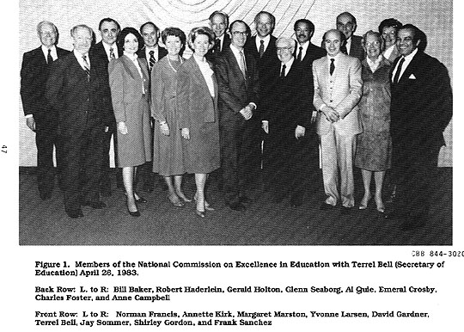
History: Nation at Risk (1983)
Notes:
Another bit of history: Nation at Risk, which ushered in the era of standards-based reform.

Slide 13

Standards-Based Reform
Notes:
While No Child Left Behind is seen as the prototype of standards-based reform, the Improving America’s Schools Act from the Clinton Administration, along with Goals 2000, presaged NCLB.

Slide 14
Section 2:
Demographics
Notes:
RFP, pp.3: High quality, early, intensive, comprehensive, and continuous child development and family support services.
RFP, pp. 7: Use relevant Head Start Performance Standards as seen in the Head Start Act, December 12, 2007.

Slide 15
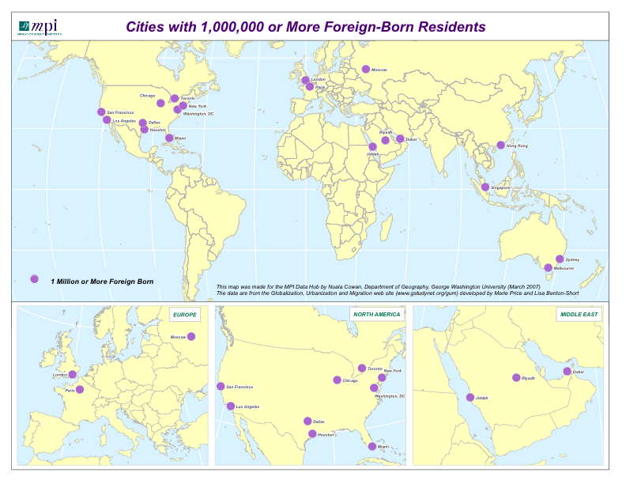
Global Migration
Notes:
Worldwide, the numbers of people who have left their countries of origin is increasing rapidly. Some researchers place the total number of migrants at 175 million, or three percent of the world population. (Bendixsen and Guchteneire, 2004)
They point out that as result of such dramatic increases both host countries and countries of origin must deal with many difficult issues such minority integration, religion, citizenship, xenophobia, human trafficking and national security.
Moreover, in the case of the children of migrants—whether foreign or native born—host countries must grapple with the challenges of providing them with a quality education in spite of both linguistic and cultural challenges.
Note: I always want to start here because so many Americans think that people only move to come here. It sometimes helps mitigate on the immigrant bashing tendencies.
15

Slide 16
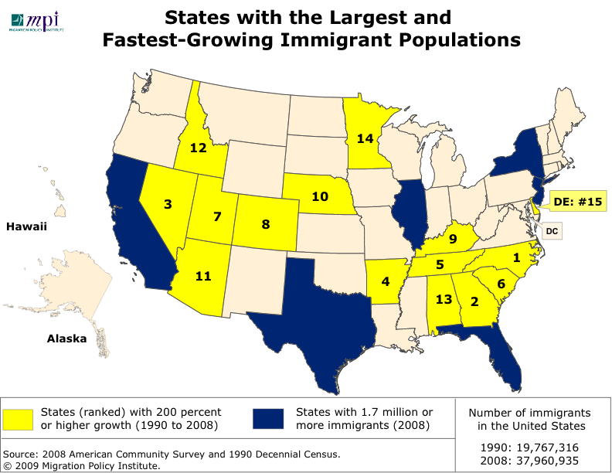
Immigrant Population in the US
Notes:
The total foreign-born population in the US has increased from a total of 19 million (or 7.9% of the population in 1990 to almost 38 million and 12.5 %of the population in 2008. A number of states have experienced a 200% or higher growth. They include states in the south such as North Carolina and Georgia and states in the west such as Nevada (ranked on this map as numbers, 1, 2, and 3.
16

Slide 17
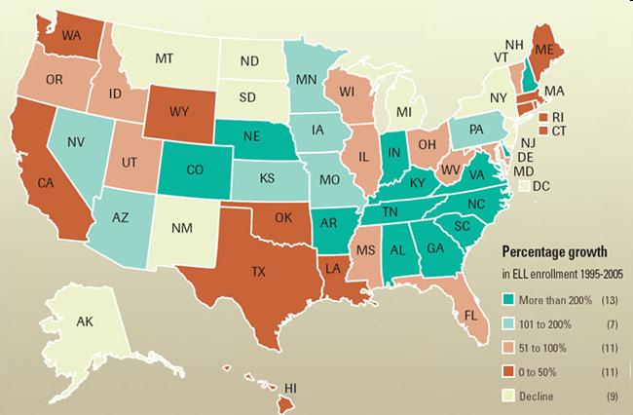
Percentage growth in ELL enrollment
SOURCE: EPE Research Center, 2009. Analysis of data from the National Clearinghouse for English Language Acquisition and the U.S. Department of Education's Common Core of Data. (http://www.edweek.org/media/2008/12/19/17immig-c1.jpg)
Notes:
This map shows the percentage of ELL growth in ELL enrollment from 1995- 2005. It presents information that complements that shown in the previous slide, except that here the focus in on the growth of ELL enrollment. Even in those states (e.g., Oklahoma) that did not show large increases in immigrant population, there was an increase in the percentage of English language learners.
As will be noted, the states that have traditionally had large numbers of immigrants (e.g., California, Texas, Florida, Illinois and New York did not increase enrollment of ELLs at the same rate as the “new immigration” states such as Georgia, South Carolina, North Carolina, and other southern states.
17

Slide 18
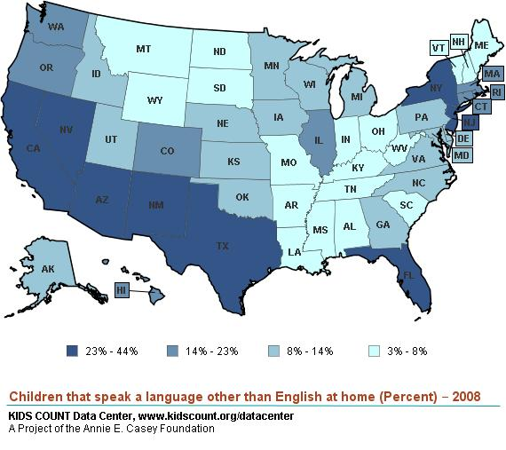
Immigrant children that speak a language other than English at home
Notes:
The fact that they have been born in the US does not mean that they are native speakers of English. As the map above makes clear, in some areas of the country 23 to 44% of immigrant origin children speak a language other than English at home.
Why it is important
Often misunderstandings about this.
People assume that Us born automatically means English as an L1
Some summary comment
If you are interested in additional demographic information, check out the website links included on the webinar website. It includes links to the Migration Policy Institute data hub that has extensive information about migration and to Kids Count, a site that has information about all children in the United States and key facts about immigrant children.
18

Slide 19
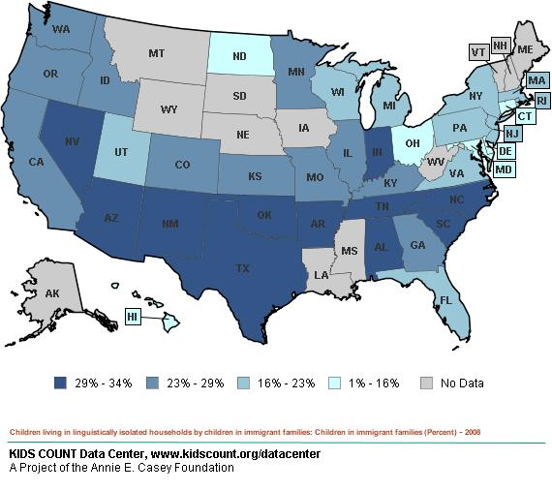
Immigrant children living in linguistically isolated households
Notes:
In many cases, these children live in linguistically isolated households. This means that no one in the household over the age of 14 reported speaking English “very well.”
19

Slide 20
Section 3
The Era of NCLB

Slide 21

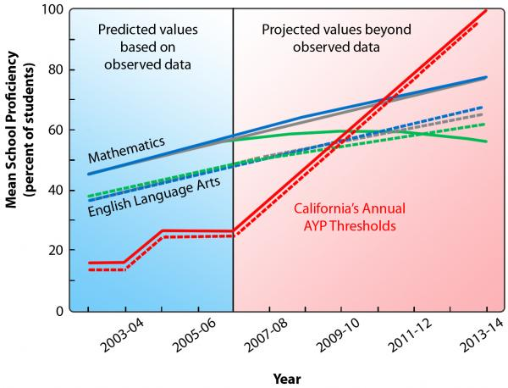
_{Highly Qualified}
_{AYP}
_{AMAO}
_{Safe Harbor}
_{Program Improvement}
Notes:
Simple visual to activate prior knowledge (and anxieties) Re: NCLB era
Key points:
-NCLB represents a sea change in how we have looked at schools, subpopulations, progress, data, etc.
-it has yielded a mixed bag of positives, not so positives, and negatives (the good, the bad, and the ugly)
-It’s not going away, and needs to be built upon

Slide 22
What do these national data tell us?
% schools meeting AYP in 2008-09 (CEP, 2010)
Notes:
Just-released data from Center on Education Policy
Key points:
-huge range of differences in school %’s meeting AYP this past year
-lots of explanations for why data look like this: how difficult standards & assessments are, how high states set the proficient bar, how easy safe harbor is, etc.
-Doesn’t really tell us about progress (snapshot of a receding goal) of students or schools over time
-Becoming less meaningful & less credible as time goes on

Slide 23
Two NCLB accountability facts from California:
ELLs on ELA constitute second-most common AYP target category missed (62% of identified districts)
Title I program improvement (PI) districts have a median EL percentage three times greater than those not PI (30.6% vs. 10.2%)
Notes:
Example from largest ELL state in the country
-Do either of these facts surprise you?

Slide 24
Characteristics of Title I Program Improvement (PI) Districts in CA
_{(Crane et al., 2008)}
Notes:
For the three “special populations,” proportional difference in % ELs is greater than that for free/reduced lunch or students with disabilities

Slide 25
NCLB & ELLs: What has worked?
Spotlight on ELLs: Title I & Title III
ELP Standards & single ELP annual assessment
Alignment of ELP to other content standards
Annual progress specified (AMAO 1, proto-growth model)
“Finish line” defined (AMAO 2, English proficient level)
Notes:
Starting with what has worked well:
clearly, ELL students are no longer hidden.
We do have basic English large proficiency standards and a statewide standardized assessment based on them
Those standards are supposed to be aligned to ELA standards as well as the academic language demands of other content standards (not always the case)
We have at least a two-year running look at how students are progressing in learning English
We have a finish line defined for what constitutes the English proficient level on that assessment

Slide 26
NCLB & ELLs: What needs improving?
ELL subgroup definition (distorts performance, weakens accountability)
Title I AYP status bar (ignores progress continuum)
Relating academic progress & achievement to ELP level, time in program
PD for mainstream teachers of ELLs (no performance without capacity)
Notes:
We know we have a problem with defining a stable population for monitoring progress and accountability:
English proficient kids flow out, lowest English proficient kids flowing in (this skimming bias distorts true progress)
We’re not seeing progress along a continuum from lowest levels of academic proficiency up to just before the proficient level (encourages states to set a low bar, as seen in earlier graphic)
How do we relate academic progress to growth in English-language proficiency? We need to.
Big issue of teacher professional development: one third of all schools (half high poverty schools) reported needing TA to improve instructional services, but only half reported receiving it.

Slide 27
NCLB & ELLs: What needs real fixing?
100% proficient by 2014 (lacks existence proof -- AYP AMAO 3)
Academic assessments often not appropriately accommodated for ELLs (invalid conclusions)
(Invalid) test-based accountability generates perverse behaviors
ELL linguistic resources largely ignored
Notes:
The bummers:
There is nowhere in America , where 100% of school population (let alone districts) are proficient
ELLs at lower English proficiency levels need more appropriate types of accommodations
If the test results are driving the system, we start getting folks gaming that system
In some instances, kids are driven into all English instruction (or even all native-language instruction) because only one counts.

Slide 28
NCLB & ELLs: Implications so far…
State and local leadership matter
Set and monitor linguistic and academic progress goals for every ELL
Focus on program coherence
Invest in prioritized, long-term PD on instructional quality
Improve assessment systems & practices including formative, interim
Notes:
What are the takeaways for leadership:

Slide 29
Section 4
Looking to the Future:
Leadership in the New Era

Slide 30

Notes:
This book is based on almost 20 years of research by the Chicago Consortium on School Research that looked at the relationship between school organization and student achievement. This book provides us with a framework in looking at school leadership.

Slide 31
Five Essential Supports
(Bryk et al, Organizing Schools for Improvement)
“School leadership sits in the first position. It acts as driver for improvements in four other organizational subsystems:
parent and community ties,
professional capacity of the faculty and staff,
a student-centered learning climate, and
an instructional guidance system.”

Slide 32
Five Essential Supports
(Bryk et al, Organizing Schools for Improvement)
“While it has been the practice of many districts and schools to concentrate reform efforts on just one or two elements within one or two of these subsystems (for example, improving the quality of teachers or mandating a common instructional curriculum), the evidence presented here attests that these systems stand in strong interaction with one another. As a consequence of this interactivity, meaningful improvement typically entails orchestrated initiatives across multiple domains.”

Slide 33

http://www.edsource.org/iss_research_SimStuEL.html
Notes:
The Chicago work gives us an important framework, but their work did not address ELLs. Here is a study that did.

Slide 34
Similar English Learner Students,
Different Results
(Williams et al., EdSource)
Seven domains:
Prioritizing student achievement
Implementing a coherent, standards-based instructional program
Using assessment data to improve student achievement and instruction
Ensuring availability of instructional resources
Enforcing high expectations for student behavior
Encouraging teacher collaboration and providing professional development
Involving and supporting parents

Slide 35
Similar English Learner Students,
Different Results
(Williams et al., EdSource)
Seven domains:
Prioritizing student achievement
Implementing a coherent, standards-based instructional program
Using assessment data to improve student achievement and instruction
Ensuring availability of instructional resources
Enforcing high expectations for student behavior
Encouraging teacher collaboration and providing professional development
Involving and supporting parents
Notes:
35

Slide 36
Similar English Learner Students,
Different Results
(Williams et al., EdSource)
Plus…
Focus on ELD instruction
Use of SDAIE strategies (in math)
ELP and ELA are strongly related.

Slide 37
Proceeding with the course…
4/13 Lessons from Chicago (and California, and New York, St. Paul, Dallas and San Francisco).
4/20 Status of federal policies (Title III briefs).
4/27 Status of best practices in English language proficiency development.
5/4 Status of best practices in academic content development.
5/11 Review of LAUSD.
5/18 Review of LAUSD.
5/25 Common Core Standards.
6/1 ESEA Reauthorization.

Slide 38

http://notebook.lausd.net/portal/page?_pageid=33,1151788&_dad=ptl&_schema=PTL_EP

